Slide 1
IT694 Computer Networks
Week4 – HTTP_I

Slide 2
What will we learn?
Understand full web request lifecycle
Place HTTP in networking stack
Client–Server architecture

Slide 3
A lifecyle of URL request
What happens when you type a URL
application
transport
network
link
physical
DNS → TCP → HTTP → Response
Name to numerical address conversion
Connection Request to SERVER
Response from SERVER

Slide 4
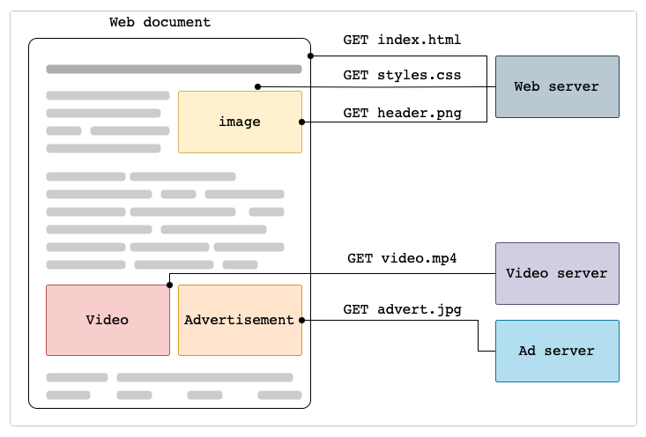
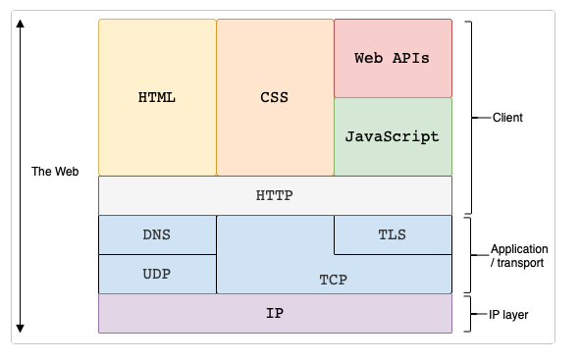
Web and HTTP
https://developer.mozilla.org/en-US/docs/Web/HTTP/Guides/Overview

Slide 5
HTTP overview (continued)
HTTP uses TCP:
client initiates TCP connection (creates socket) to server, port 80
server accepts TCP connection from client
HTTP messages (application-layer protocol messages) exchanged between browser (HTTP client) and Web server (HTTP server)
TCP connection closed
HTTP is “stateless”
server maintains no information about past client requests
aside
protocols that maintain “state” are complex!
past history (state) must be maintained
if server/client crashes, their views of “state” may be inconsistent, must be reconciled

Slide 6


HTTP overview
HTTP: hypertext transfer protocol
Web’s application-layer protocol
client/server model:
client: browser that requests, receives, (using HTTP protocol) and “displays” Web objects
server: Web server sends (using HTTP protocol) objects in response to requests
HTTP request
PC running
Firefox browser
HTTP response
HTTP request
server running
Apache Web
server
HTTP response
iPhone running
Safari browser

Slide 7
HTTP request message
two types of HTTP messages: request, response
HTTP request message:
ASCII (human-readable format)
carriage return character
line-feed character
request line (GET, POST,
HEAD commands)
GET /index.html HTTP/1.1\r\n
Host: www-net.cs.umass.edu\r\n
User-Agent: Mozilla/5.0 (Macintosh; Intel Mac OS X 10.15; rv:80.0) Gecko/20100101 Firefox/80.0 \r\n
Accept: text/html,application/xhtml+xml\r\n
Accept-Language: en-us,en;q=0.5\r\n
Accept-Encoding: gzip,deflate\r\n
Connection: keep-alive\r\n
\r\n
header
lines
carriage return, line feed at start of line indicates end of header lines
* Check out the online interactive exercises for more examples: http://gaia.cs.umass.edu/kurose_ross/interactive/

Slide 8
HTTP request message: general format
method
sp
URL
sp
version
cr
lf
request
line
header field name
value
cr
lf
~
~
header
lines
~
~
header field name
value
cr
lf
cr
lf
~
entity body
~
body
~
~

Slide 9
Other HTTP request messages
POST method:
web page often includes form input
user input sent from client to server in entity body of HTTP POST request message
HEAD method:
requests headers (only) that would be returned if specified URL were requested with an HTTP GET method.
PUT method:
uploads new file (object) to server
completely replaces file that exists at specified URL with content in entity body of POST HTTP request message
GET method (for sending data to server):
include user data in URL field of HTTP GET request message (following a ‘?’):
www.somesite.com/animalsearch?monkeys&banana

Slide 10
HTTP response message
status line (protocol
status code status phrase)
HTTP/1.1 200 OK
Date: Tue, 08 Sep 2020 00:53:20 GMT
Server: Apache/2.4.6 (CentOS) OpenSSL/1.0.2k-fips PHP/7.4.9 mod_perl/2.0.11 Perl/v5.16.3
Last-Modified: Tue, 01 Mar 2016 18:57:50 GMT
ETag: "a5b-52d015789ee9e"
Accept-Ranges: bytes
Content-Length: 2651
Content-Type: text/html; charset=UTF-8
\r\n
data data data data data ...
header
lines
data, e.g., requested
HTML file
* Check out the online interactive exercises for more examples: http://gaia.cs.umass.edu/kurose_ross/interactive/

Slide 11
HTTP connections: two types
Non-persistent HTTP
TCP connection opened
at most one object sent over TCP connection
TCP connection closed
downloading multiple objects required multiple connections
Persistent HTTP
TCP connection opened to a server
multiple objects can be sent over single TCP connection between client, and that server
TCP connection closed

Slide 12
Non-persistent HTTP: example
User enters URL:
www.someSchool.edu/someDepartment/home.index
(containing text, references to 10 jpeg images)
1a. HTTP client initiates TCP connection to HTTP server (process) at www.someSchool.edu on port 80
1b. HTTP server at host www.someSchool.edu waiting for TCP connection at port 80 “accepts” connection, notifying client
2. HTTP client sends HTTP request message (containing URL) into TCP connection socket. Message indicates that client wants object someDepartment/home.index
3. HTTP server receives request message, forms response message containing requested object, and sends message into its socket
time

Slide 13
Non-persistent HTTP: example (cont.)
User enters URL:
www.someSchool.edu/someDepartment/home.index
(containing text, references to 10 jpeg images)
4. HTTP server closes TCP connection.
5. HTTP client receives response message containing html file, displays html. Parsing html file, finds 10 referenced jpeg objects
6. Steps 1-5 repeated for each of 10 jpeg objects
time

Slide 14
Non-persistent HTTP: response time
RTT (definition): time for a small packet to travel from client to server and back
HTTP response time (per object):
one RTT to initiate TCP connection
one RTT for HTTP request and first few bytes of HTTP response to return
object/file transmission time
initiate TCP
connection
RTT
request file
RTT
time to
transmit
file
file received
time
time
Non-persistent HTTP response time = 2RTT+ file transmission time

Slide 15
Persistent HTTP (HTTP 1.1)
Non-persistent HTTP issues:
requires 2 RTTs per object
OS overhead for each TCP connection
browsers often open multiple parallel TCP connections to fetch referenced objects in parallel
Persistent HTTP (HTTP1.1):
server leaves connection open after sending response
subsequent HTTP messages between same client/server sent over open connection
client sends requests as soon as it encounters a referenced object
as little as one RTT for all the referenced objects (cutting response time in half)

Slide 16
HTTP response status codes
status code appears in 1st line in server-to-client response message.
some sample codes:
200 OK
request succeeded, requested object later in this message
301 Moved Permanently
requested object moved, new location specified later in this message (in Location: field)
400 Bad Request
request msg not understood by server
404 Not Found
requested document not found on this server
505 HTTP Version Not Supported

